Slide 1

Data flow diagram (DFD)
PRESENTED BY:
GAURAV GHIMIRE

Slide 2
INTRODUCTION
DFD is data flow diagram.
It is also known as bubble chart.
Represent the flow of data graphically.
It shows the incoming data flow , out going data flow and store the data in graphical form.
It show the how data is process in a system in terms of input and output.

Slide 3
SYMBOL FOR DFD
External entity
Data flow
Process or bubble
Data store

Slide 4
RULES OF DFD
Each process should have at least one input and one output
At least one data flow-in and one data flow-out
All process in DFD should travel to another process or data store place.

Slide 5
LEVELS OF DFD
0th level of DFD
1st level of DFD
2nd level of DFD

Slide 6
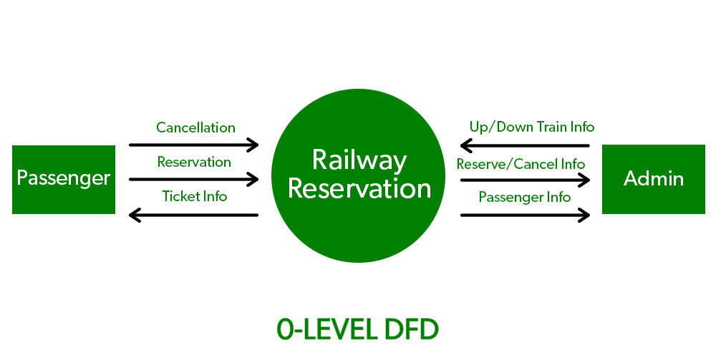
0th level of DFD
It has single process
It takes input from the external entity
Process
Provide required output

Slide 7
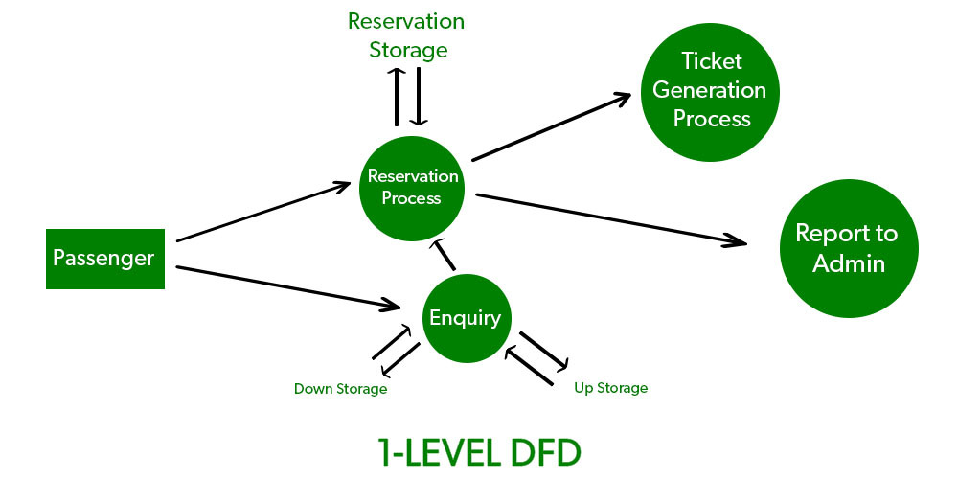
1st level DFD
It is a detail version of previous one
It include the database and various important units

Slide 8
2nd level DFD
Single module are pick
Functionality are completely define

Slide 9
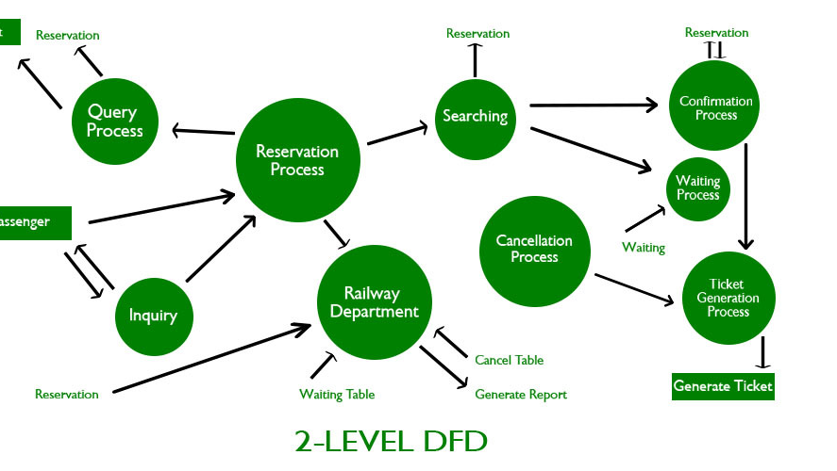

Slide 10


